Slide 1
Community Commons
Chris Fulcher
Center for Applied Research and Environmental Systems (CARES)
University of Missouri

Slide 2
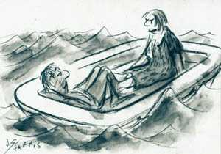
Water, water everywhere
but not a drop to drink…
Similarly…
Data, data everywhere
but not a BYTE to think…

Slide 3
Community Commons
…Is an interactive mapping, networking, and learning utility for the broad-based healthy, sustainable, and livable communities’ movement
...Brings change-makers together to connect with thought leaders and peers, share their stories and strategies, and access and map community data
…Now over 40,000 registered users

Slide 4
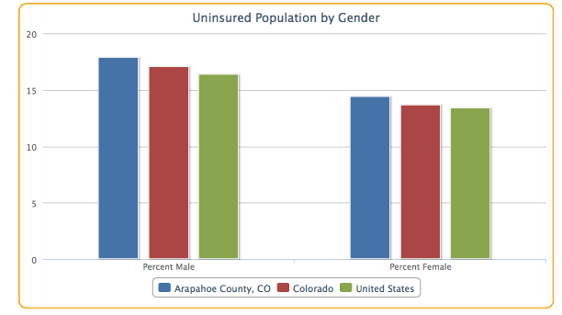
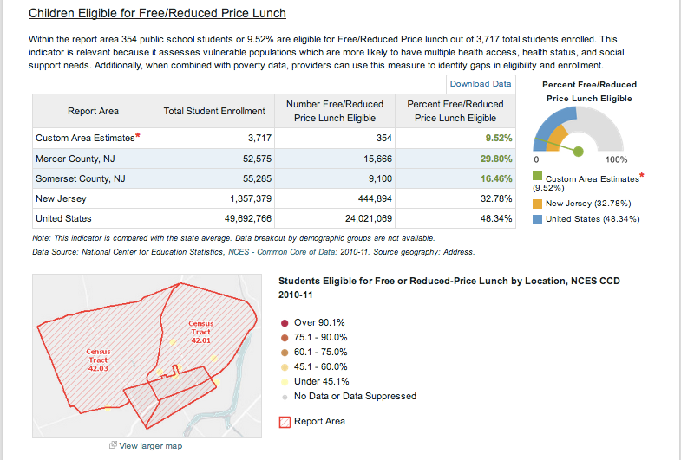
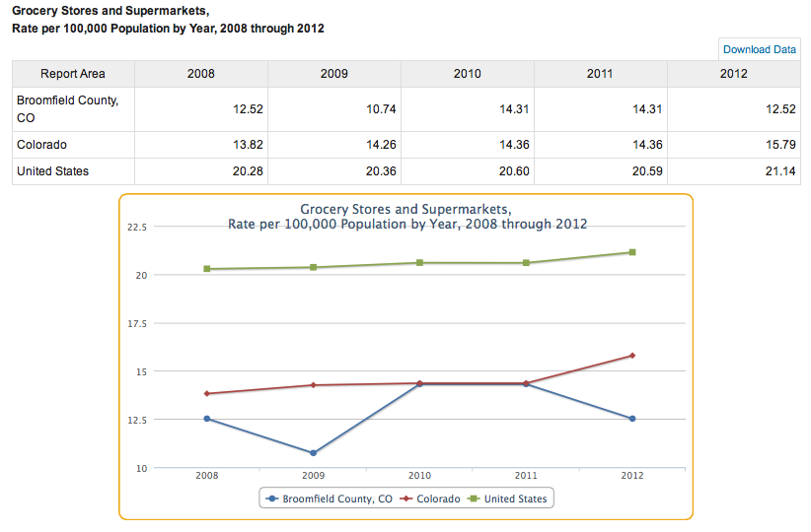
Provides public access to stories, meaningful data, mapping and reporting tools…

Slide 5
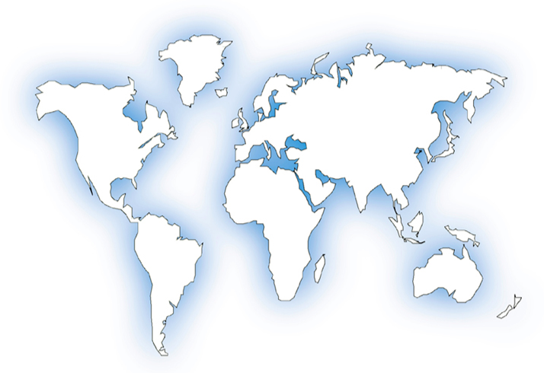
A Global Web-based Mapping System
Environment
Transportation
Education
Demographic
Free
Access to Thousands
Of Available Maps
and
Reporting Tools
Food
Health
Housing
Civic
Poverty
Political
Economic /
Income
Emergency
Management

Slide 6
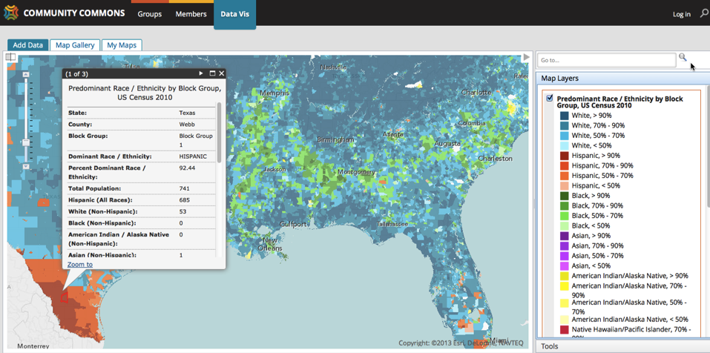
Example: Predominant Race/Ethnicity
by Block Group Census 2010

Slide 7
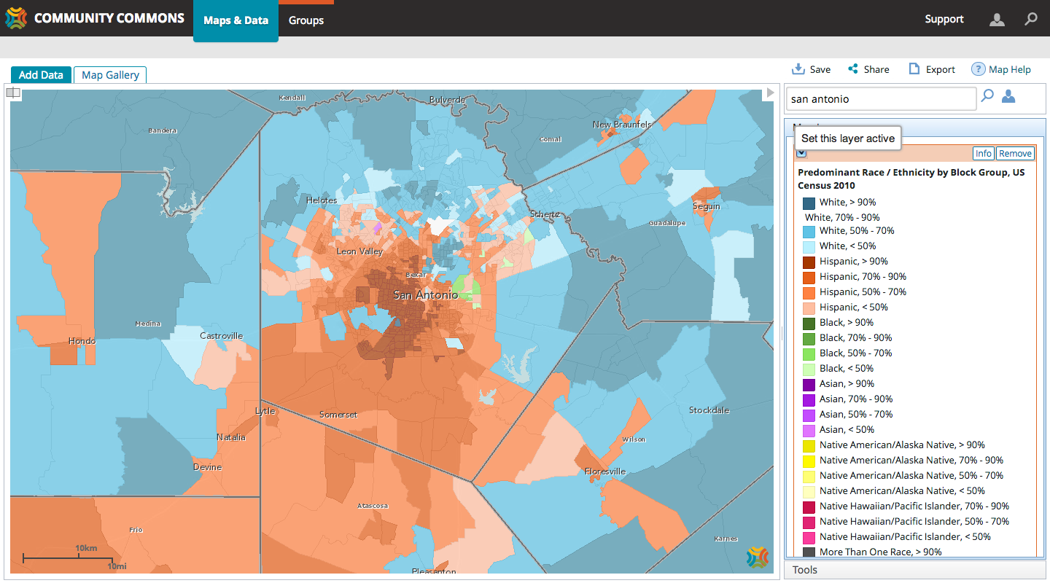
Zooming into San Antonio: Predominant Race/Ethnicity by Block Group Census 2010

Slide 8
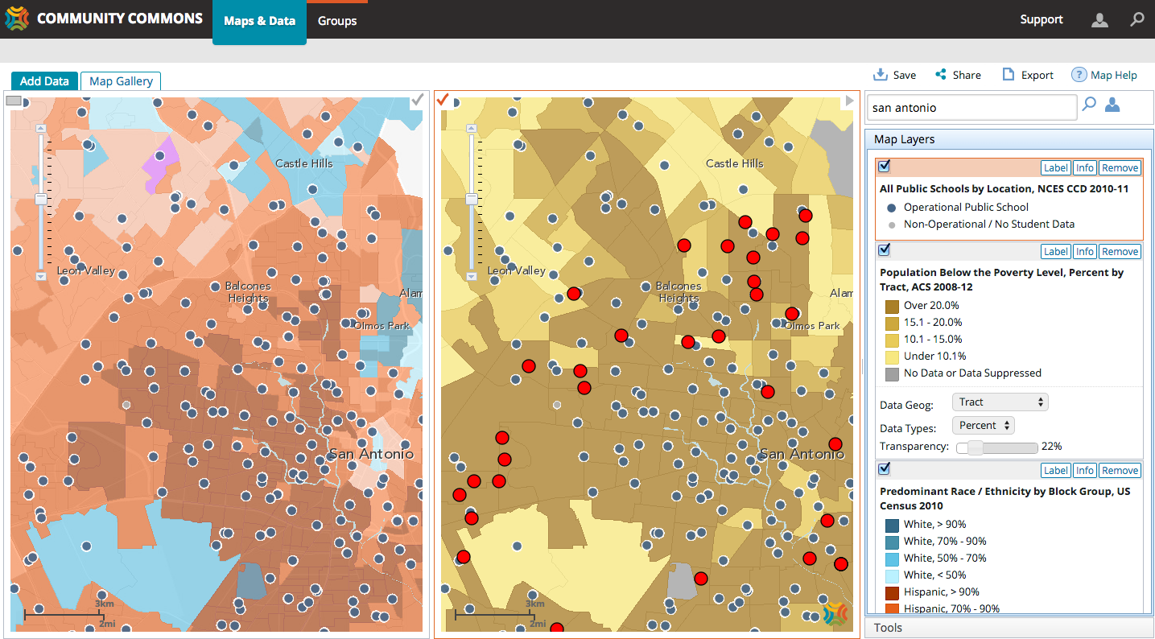
Split Screen: Predominant Race/Ethnicity, Poverty and Public Schools

Slide 9
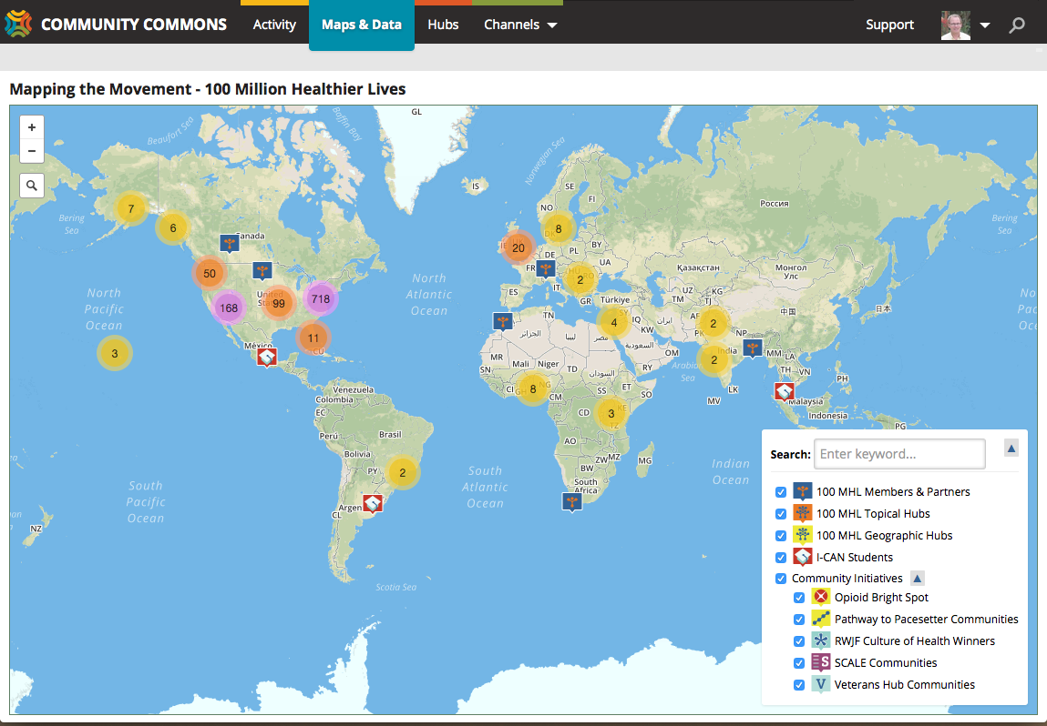

Slide 10
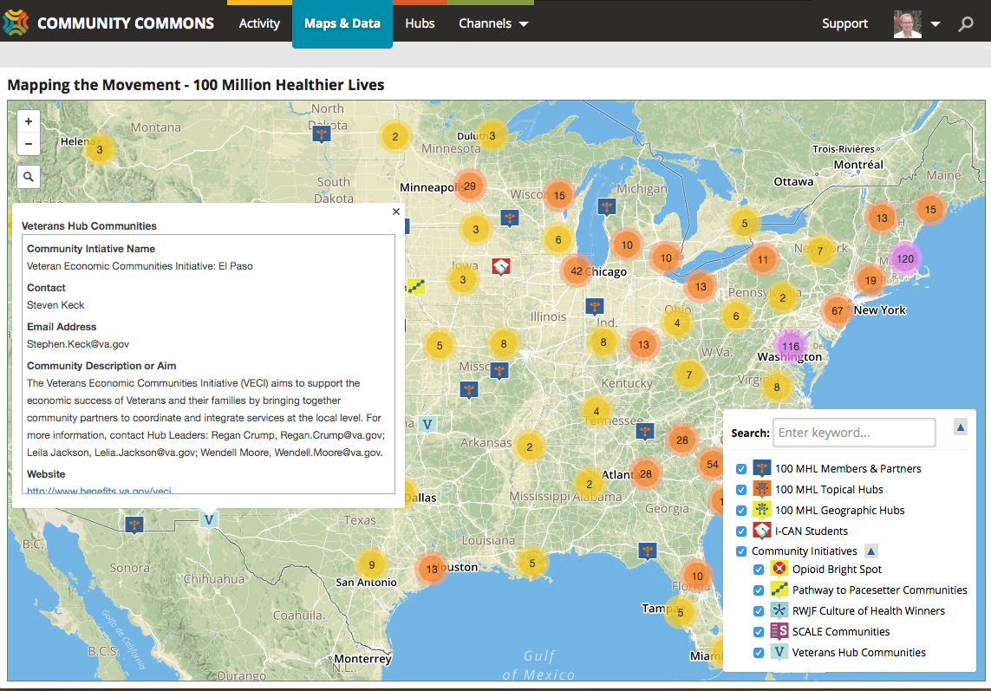

Slide 11
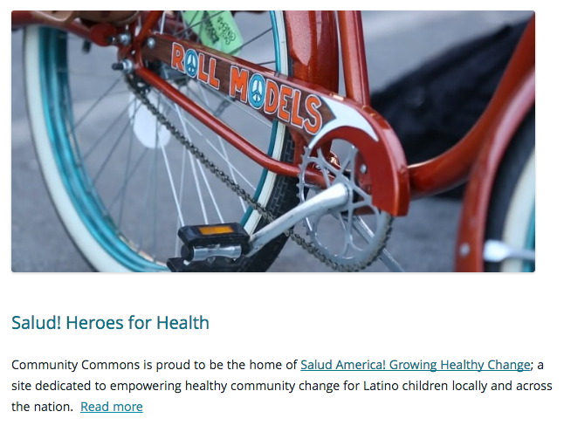
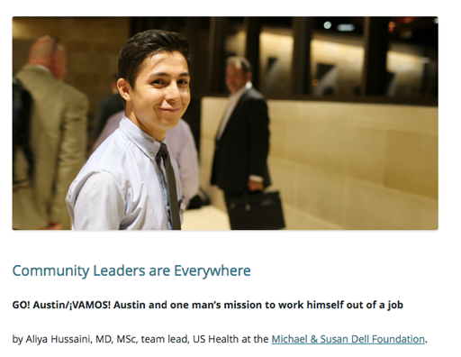
Organizations learn from each other through curated stories and share strategies and best practices…

Slide 12
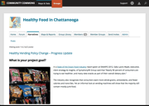
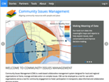
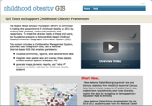
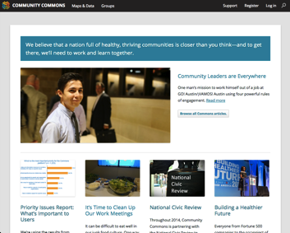
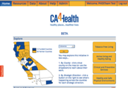
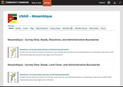
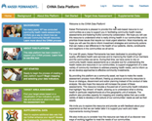
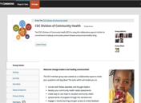
Standard
“Hub”
RWJF
COGIS
United Ways
Connected
systems lead
to coherent
conversations
PHI
USAID
KP
WKKF
CDC

Slide 13
Current Data and Technology Infrastructure
University of Missouri Servers
AHA
Hub
KP CHNA
Hub
Community
Commons
Custom
Platforms
RWJF
Hub
COFPN
Hub
Mapping, Reporting, Curation, Networking, Social Media, User Experience (UX)
CARES Data Engine
The Commons and all custom platforms are currently housed on University of Missouri Servers

Slide 14
Where We’re Going…
Technology
Partners
Cloud Hosting
Technology
Partners
Technology Partner:
CARES
Custom
App
Custom
Report
Community
Commons
Custom
Platforms
Custom
Maps
Custom
Tools
Partner API Engines
CARES API Engine
Partner Data Engines
CARES Data Engine
Cloud Servers
University of Missouri Servers

Slide 15
Leadership
Thoughts on what we’re missing…

Slide 16
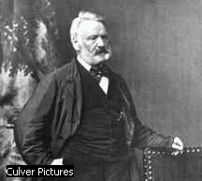
“Teach… as much as you can; society is culpable in not providing instruction for all and it must answer for the night which it produces. If the soul is left in darkness sins will be committed. The guilty one is not he who commits the sin but he who causes the darkness.”
Victor Hugo “Les Miserables” (1862)

Slide 17
However…
“Many programs run by the professional improvers of society are built on education, not training – on delivering facts rather than strengthening practice. Knowledge matters.”
“But our efforts too often stop at knowledge, because it’s easier to measure what we’ve told people than it is to measure how we’ve changed people. It is easier to preach to people than to practice with them.”
“Resilience: Hard-Won Wisdom for Living a Better Life” by Eric Greitens

Slide 18
“Is the problem really that people don’t know enough? Or is it that they don’t do enough of the right stuff? It’s an important question to ask, because it helps us get clear on the relationship between education and training.”
“We often assume that learning is enough, that once we know something is good or right or wise, we’ll act on that knowledge. Only rarely is that true… Our intentions and our actions never line up as perfectly as we like.”

Slide 19
“Knowledge in itself does not affect change. Action based on knowledge affects change.”

